Slide 1
Why map? Thinking spatially
Mark Green
DASC507 – Advanced Biostatistics II
Analysis Methods for Complex Data Structures

Slide 2
Outline
Key terms
Why map?
Case studies of the power of mapping/spatial analysis
Importance of thinking spatially
Types of maps
Vector data
Raster data
Criticisms

Slide 3
Key terms
GIS stands for Geographic Information System
“GIS are computer-based systems for the integration and analysis of geographic data” (Cromley and McLafferty, 2012; emphasis my own)
Linked to GIScience which is more critically reflective over the use of GIS and related spatial analysis tools

Slide 4
Key terms
There are 3 main functions that a GIS will offer:
Spatial database management
Visualisation (mapping)
Spatial analysis

Slide 5
Key terms
Geographic Data Science
“…combines the long-standing tradition and epistemologies of Geographic Information Science and Geography with many of the recent advances that have given Data Science its relevance in an emerging “datafied” world.” (Singleton and Arribas-Bel, 2021, p67)

Slide 6
Key terms
Five ‘w’s of information gathering:
Who
What
When
Where
How

Slide 7
Key terms
Mapping/spatial analysis can be top down or bottom up
Top-down: one person (or group) maps a population
Bottom-up: public participation of the mapping process i.e. GIS directly created by and serves a population
Both create opportunities to improve health and supplement the policy decision making process

Slide 8
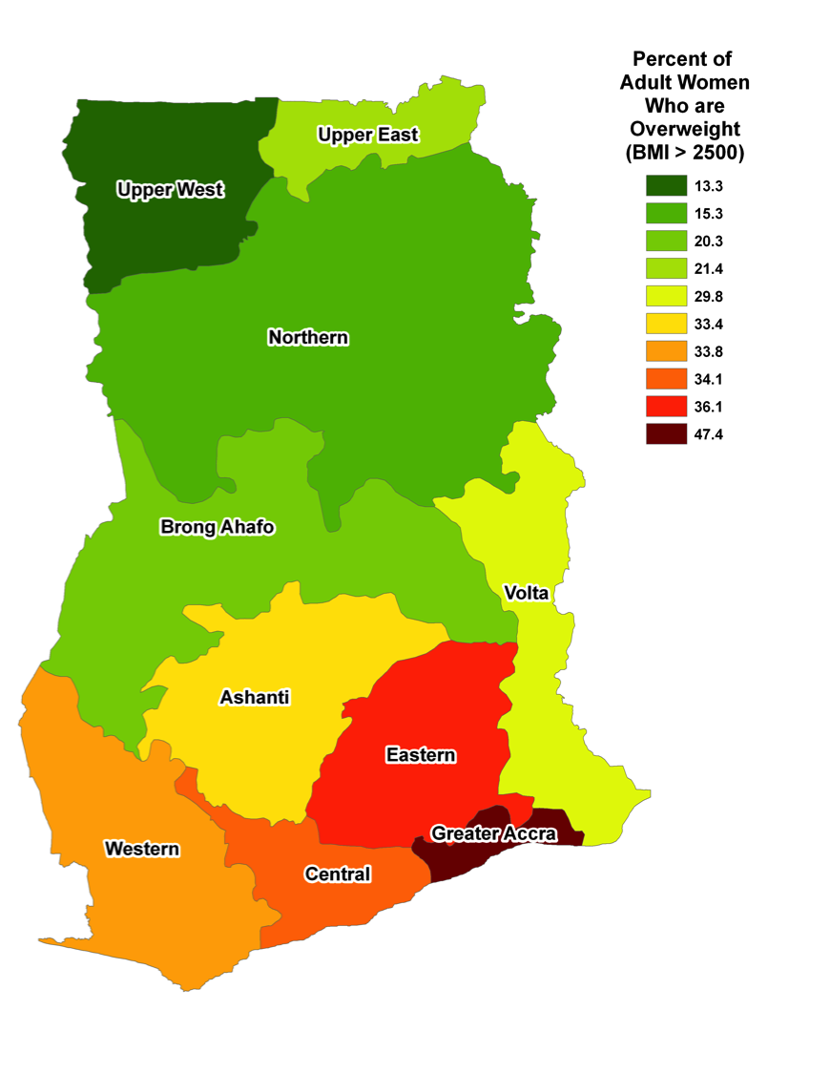
Key terms
An example of a top down approach (Source: http://geog.sdsu.edu/Research/Projects/IPC/publication/Weeks_Hill_Stoler_Spatial%20Inequalities.pdf)

Slide 9
Key terms
Example of bottom-up approach
Breast Cancer Incidence in Long Island, New York
Local community action groups used GIS to explore breast cancer prevalence, which drew attention to the issue and attracted funding for larger research studies examining possible factors identified by the group
http://li-gis.cancer.gov/

Slide 10
Why map?
Makes the spatial explicit
A picture can say a thousand words
Can allow users to actively engage with (spatial) data

Slide 11
Why map?
John Snow identified mode of transmission of cholera. Maps helped support his evidence base. Notice the clustering of deaths around one particular pump in Soho, London.

Slide 12
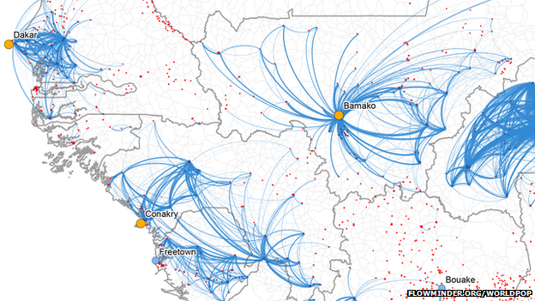
Why map?
In 2015, researchers used IBM mobile phone data and GIS to predict population movements to identify where Ebola might spread to after outbreaks in settlements.

Slide 13

Why map?
When trying to think about what influences our health, we often focus on the characteristics of individuals…

Slide 14

Why map?
…but individuals don’t live in a social vacuum, they interact with society including the neighbourhoods around them

Slide 15
Types of maps
Vector data – reproducing features of the World captured through any of the following
Points – simple dots e.g. fast food outlet
Lines – connecting points e.g. roads
Polygons – connection of lines bounded by a closed path e.g. city region
Commonly visualised using thematic maps

Slide 16
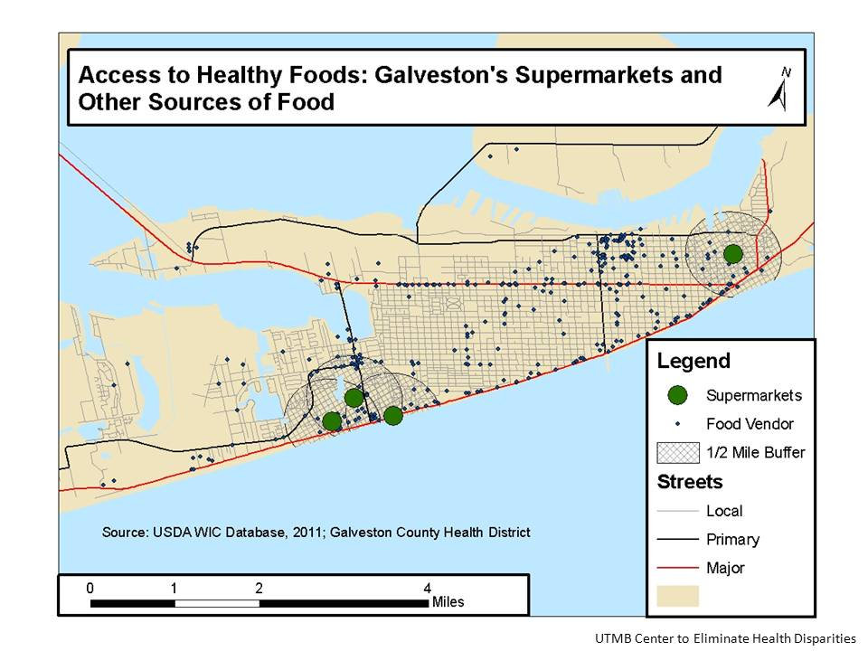
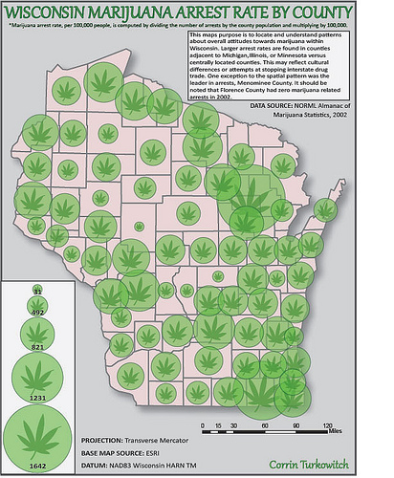
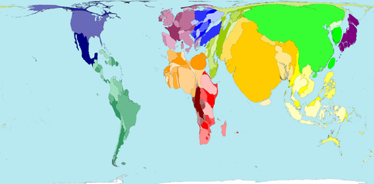
Types of maps
Thematic maps
Choropleth maps
Dot distribution or density maps
Graduated symbol
Cartograms

Slide 17
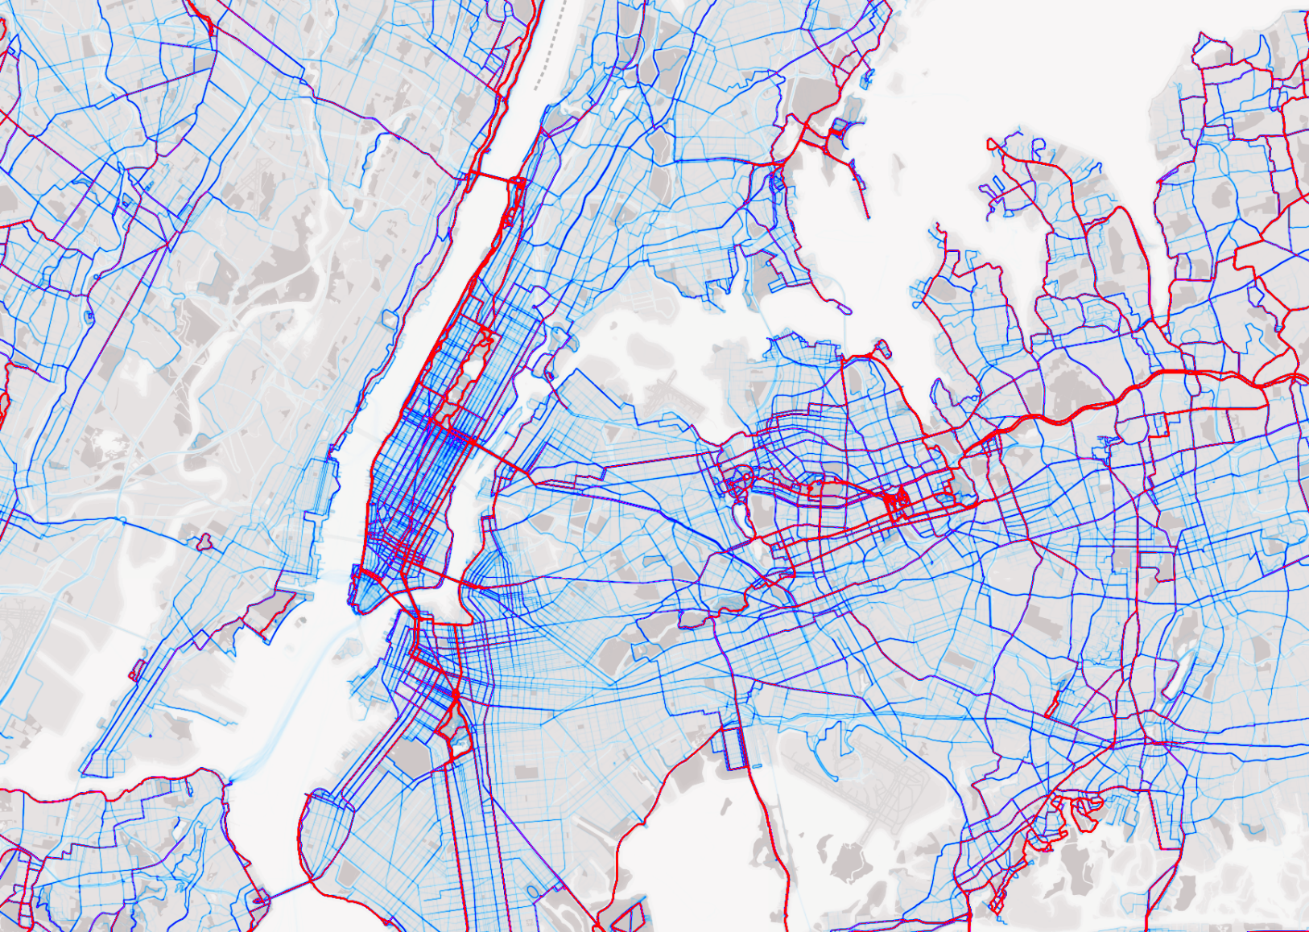
Types of maps
Thematic maps
Flow maps for representing movement data or data for connected points

Slide 18
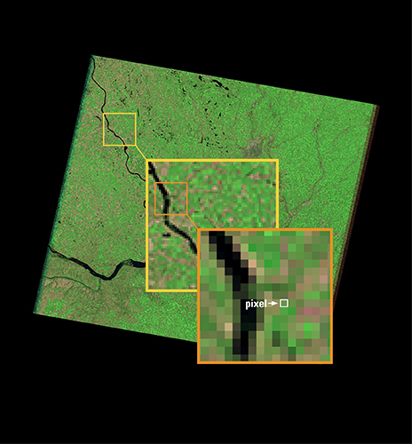
Types of maps
Raster data – pixel-based images representing continuous surfaces
Remote sensing/satellites (e.g., green space)
Modelled surfaces (e.g., air quality)
Digital photographs (e.g., john snow map)
Less common in public health

Slide 19
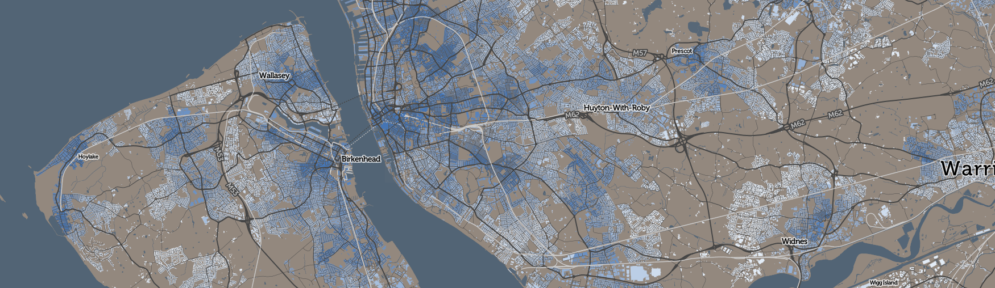
Types of maps
Maps can be static, dynamic or interactive…

Slide 20
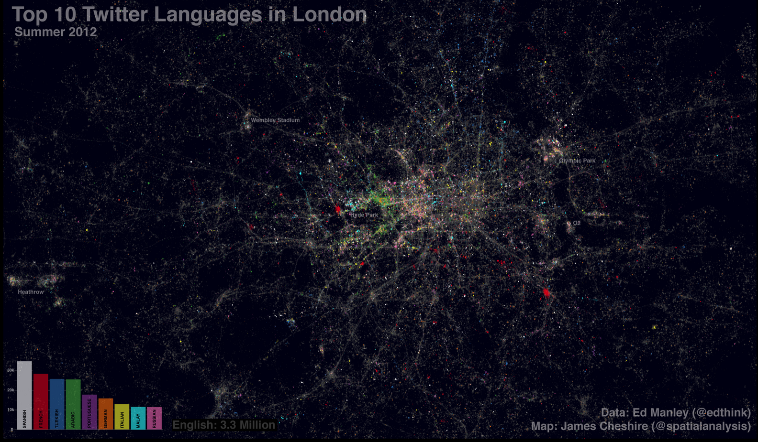
Types of maps
Recent explosion in spatial (big) data aided by smart phones and geotagged information (e.g. Twitter)

Slide 21

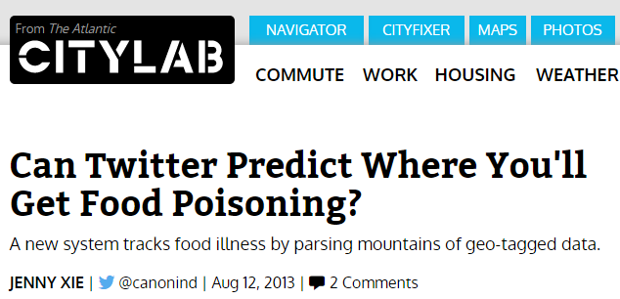
Types of maps
And this has important implications for understanding and dealing with public health…

Slide 22
Criticisms
Spatial health data does not always exist limiting usage
Ecological fallacy
Modifiable Areal Unit Problem
Scale matters (smaller the better)
Smoothed surfaces or polygons may not reflect underlying geography
Who is represented in maps?
Easy to manipulate and mislead the reader (like any visualisation)

Slide 23
Further reading
Cromley E, McLafferty S. 2012. GIS and Public Health. Guildford Press: New York.
Musa et al. 2013. Use of GIS Mapping as a Public Health Tool–-From Cholera to Cancer. Health Services Insights 6: 111-116. https://doi.org/10.4137/HSI.S10471
Singleton A, Arribas Bel D. 2021. Geographic Data Science. Geographical Analysis 53: 61-75. https://doi.org/10.1111/gean.12194

